Slide 1
Tree Plant Village
Plant Leaf Disease Detection Using CNN
Mini Project Presentation

Slide 2
Presented By:
Name | Id
Arafat Islam | 2022-3-60-303
Bushra Jahan Monira | 2022-3-60-241
Abir Mohd.Sajedul Hossain | 2022-2-50-004
Khadiza Ahamed Tayeba | 2022-2-50-007
Pallon Nath | 2022-3-60-223

Slide 3
Introduction
Tree Plant Village is a deep learning–based project designed to detect plant diseases automatically using leaf images. In this project, image data of plant leaves is collected from the well-known PlantVillage dataset.The dataset contains images of both healthy and diseased plant leaves from different plant categories. By using a Convolutional Neural Network (CNN), the system learns important visual features from the leaf images and classifies them as healthy or diseased. The main goal of this project is to help in early disease detection, which can support farmers and reduce crop loss through timely action..

Slide 4
Dataset Overview
Dataset Source: PlantVillage Dataset (Kaggle)
A publicly available dataset collected from Kaggle, widely used for plant disease detection research.
Contains images of healthy and diseased plant leaves
Includes leaf images of both healthy plants and plants affected by different diseases.
Multiple plant categories and disease classes
Covers various plant types, each having multiple disease categories, making it a multi-class problem.
Images are divided into training and testing sets
The dataset is split into training and testing sets to train the model and evaluate its performance.

Slide 5
Task 1: Exploratory Data Analysis (EDA)
Dataset Structure & Class Distribution: Analyzed dataset folders, image formats, and distribution of different classes.
Images per Class: Checked the number of images in each class to understand data balance.
Sample Image Visualization: Displayed sample images from different plant categories and diseases.
Class Imbalance & Image Patterns: Identified class imbalance and observed image resolution variations.

Slide 6
Task-2: Transfer Learning Workflow
To build a strong baseline model for tomato leaf disease classification using pre-trained CNNs
Select PlantVillage dataset (only tomato classes – 10 classes)
Resize and normalize tomato leaf images
Load pre-trained models (VGG16, ResNet50, EfficientNetB0)
Freeze pre-trained layers to retain learned features
Add custom classification layers for tomato diseases
Train the models using the training dataset
Evaluate performance using test data
Compare results using accuracy and F1-macro score

Slide 7
Task-2: Transfer Learning Workflow
Outcome
Transfer learning provides a reliable baseline, but performance is limited due to generic features learned from non-agricultural images.

Slide 8
Task-3: Custom CNN Workflow (Best Performing Model
To design a CNN architecture specifically optimized for tomato leaf disease classification.
Input tomato leaf images into the custom CNN
Apply convolution layers to extract disease-related features
Use ReLU activation to introduce non-linearity
Apply max-pooling to reduce spatial dimensions
Use dropout layers to prevent overfitting
Convert extracted features using global average pooling
Classify diseases using fully connected layers
Output final prediction using Softmax activation.

Slide 9
Task-3: Custom CNN Workflow (Best Performing Model
Outcome
The custom CNN achieves the highest accuracy and F1-macro score due to dataset-specific learning and reduced model complexity.

Slide 10
Task-4: Advanced CNN (CGNet / Attention-Based Model) Workflow
To improve feature extraction by focusing on important disease regions within the leaf image.
Input tomato leaf images into an advanced CNN architecture
Extract hierarchical features using deeper convolution layers
Emphasize important disease regions using efficient feature learning
Reduce redundant information through optimized network design
Train the model with the same dataset for fair comparison
Evaluate performance against previous tasks

Slide 11
Task-4: Advanced CNN (CGNet / Attention-Based Model) Workflow
Outcome
Advanced CNN models improve robustness and feature focus, but overall performance depends on dataset size and model complexity.
Accuracy is 95.60%.

Slide 12
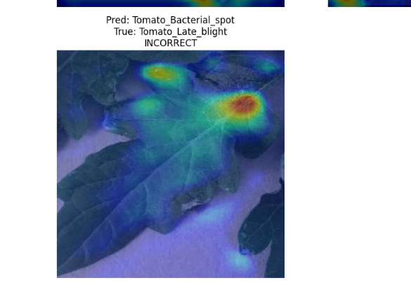
Task-5: Grad-CAM (Model Explainability) Workflow
To explain why the CNN predicts a specific tomato leaf disease.
Select a trained model (best performing Custom CNN)
Input a tomato leaf image into the modelCompute gradients of the predicted class
Identify important convolution feature maps
Generate a heatmap highlighting important regions
Overlay the heatmap on the original image
Visualize disease-focused areas

Slide 13
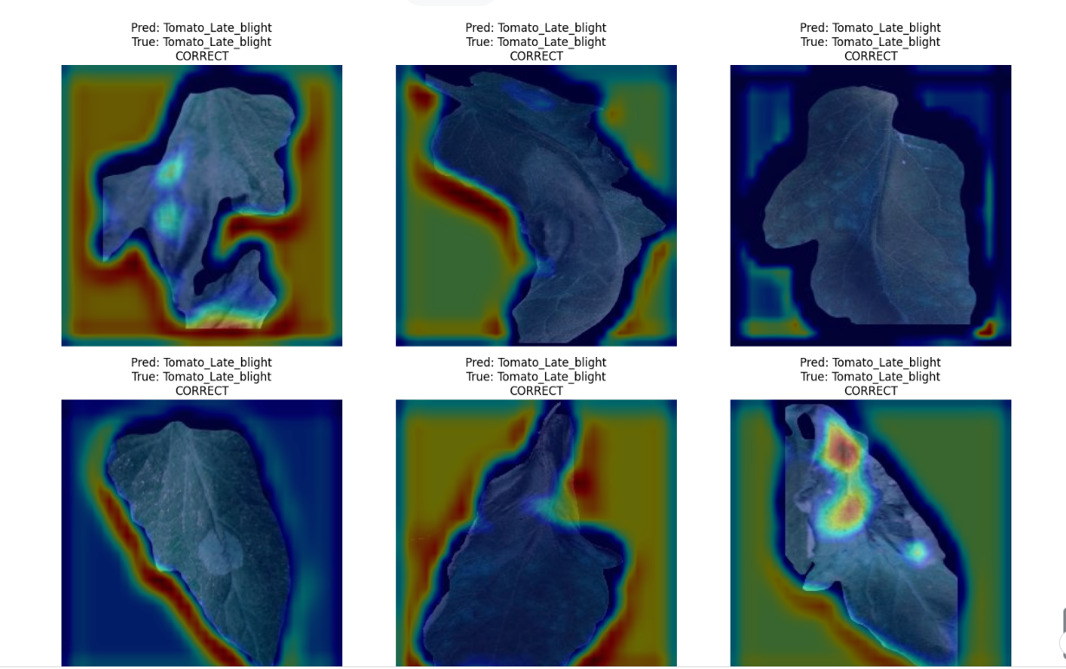
Task-5: Grad-CAM (Model Explainability) Workflow
Outcome
Grad-CAM confirms that the model focuses on actual disease-affected regions, making predictions transparent and trustworthy.
Grad-CAM Sample Images:

Slide 14
Results
CNN achieved high accuracy on plant leaf classification.
Training accuracy showed steady improvement.
Validation accuracy confirmed good generalization.
Model successfully distinguishes healthy and diseased leaves.

Slide 15
Applications of Tree Plant Village
Early detection of plant diseases.
Helps farmers take preventive measures.
Reduces crop loss and increases productivity.
Can be extended to mobile or web applications.

Slide 16
Conclusion
Tree Plant Village provides an effective and practical solution for detecting plant diseases using image data. The use of Convolutional Neural Networks (CNNs) shows strong performance in image-based classification tasks, enabling accurate identification of plant health conditions. Overall, this project successfully demonstrates a real-world application of deep learning technology in agriculture, helping improve disease diagnosis and supporting smarter farming practices.

Slide 17
Thank You
Thank you for your attention.
Any Questions?

